Slide 1
SQL Data Cleaning Project: Global Layoffs

Slide 2
The Data Cleaning Blueprint
01
Establish a Staging Area
Create a working copy of your raw data to ensure data integrity and traceability.
02 03
Identify & Remove Standardize & Correct Duplicates Data
Pinpoint and eliminate redundant Unify inconsistent formats and rectify entries that can skew analysis. errors for uniform data representation.
04
Address Null Values
Strategically handle missing data points, either by imputation or removal.
05
Refine Dataset Structure
Remove unnecessary columns or rows to streamline the dataset for analysis.

Slide 3

Step 1: Staging Your Data
Why Stage Data?
•
Preserve raw data source.
Isolate cleaning operations. Facilitate iterative cleaning.
•
•
GML Code
CREATE TABLE w orld_layo fs.layo fs_staging LIKE w orld_layoffs.layoffs;
IN SERT layo fs_staging
SELECT * FRO M w orld_layo fs.layo fs;
This staging table acts as a safe environment where you can perform all your

Slide 4

Step 2: Identifying & Removing Duplicates
Duplicate records can significantly impact your analysis, leading to inflated counts or incorrect aggregations.
Detecting Duplicates
SELECT *,
RO W _N U M BER()O VER (
PARTITIO N BY com pany,location, industry,total_laid_o f, percentage_laid_o f,date, stage,country,
funds_raised_m ilions
)AS row _num
FRO M w orld_layo fs.layo fs_staging;
Removing Duplicates

Slide 5

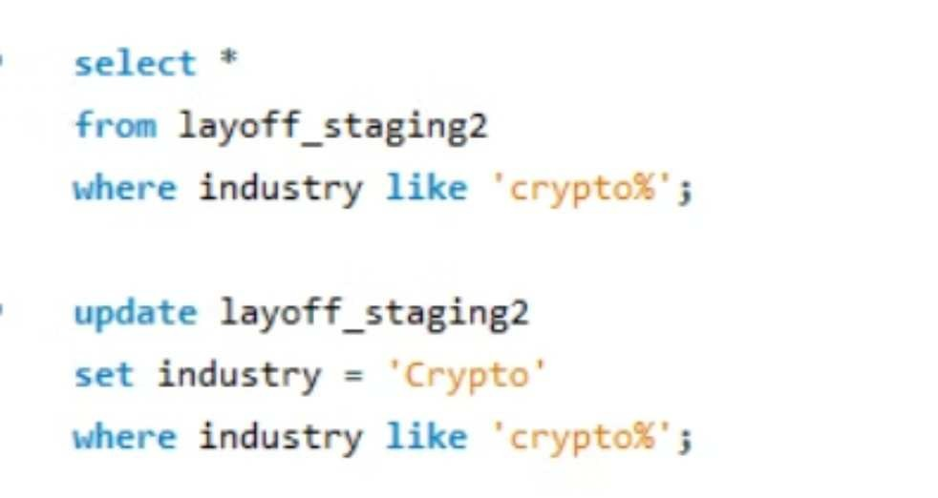
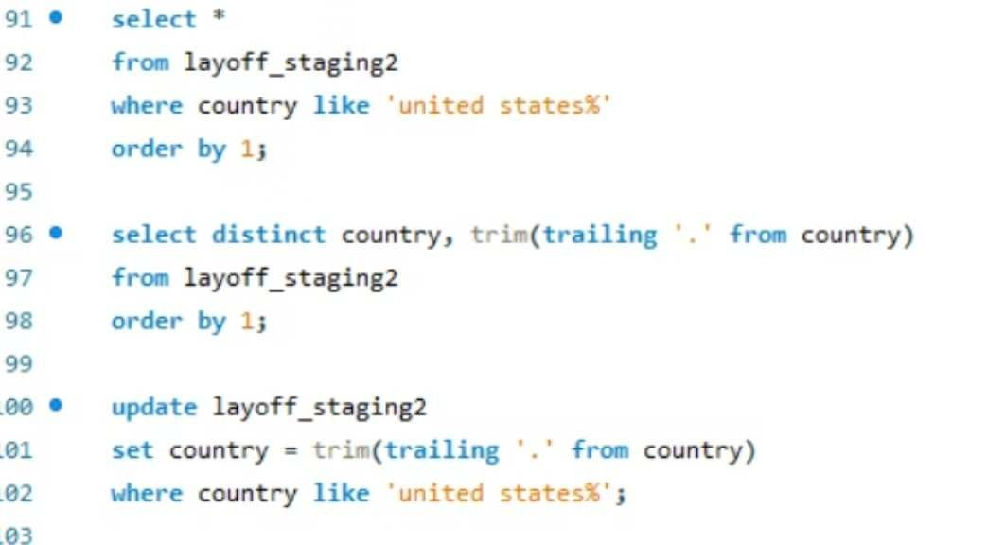
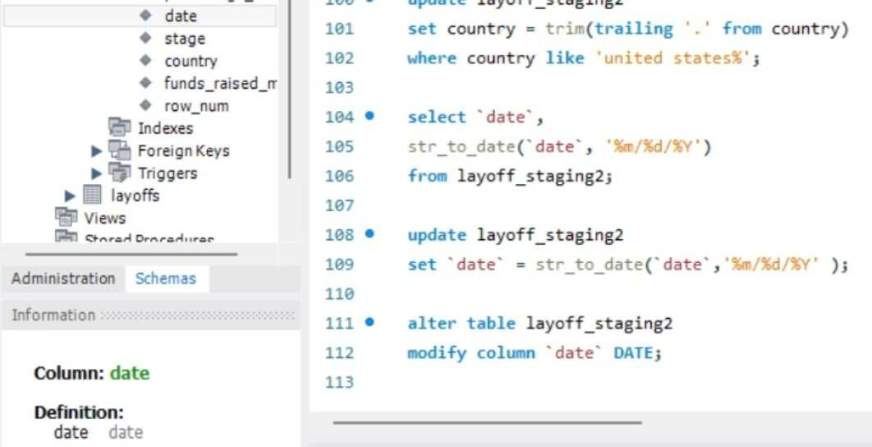
Step 3: Standardizing Data Formats
Standardizing data ensures that all entries for a given attribute are uniform. This includes correcting typos, unifying categorical values, and formatting dates correctly.
Consolidate Industries
Group similar categories like 'Crypto Currency' and 'CryptoCurrency' into a single 'Crypto' entry.
Clean Country Names
Remove trailing punctuation or extra spaces from country names.
Format Date Fields
Convert date strings into a consistent DATE format for accurate temporal analysis.

Slide 6

Handling Nulls and Empty Strings
For categorical fields, it's often beneficial to convert empty strings to NULL for easier processing and consistent handling.
Converting Blanks to Nulls
U PD ATE w orld_layoffs.layoffs_staging2 SET industry = N U LL
W H ERE industry = ';
For fields where a valid value exists for other records of the same entity (e.g., company), you can impute missing values by joining the table to itself.
Imputing Missing Values
U PD ATE layoffs_staging2 t1 JO IN layoffs_staging2 t2
O N t1.com pany = t2.com pany SET t1.industry = t2.industry W H ERE t1.industry IS N U LL AN D t2.industry IS N O T N U LL;

Slide 7





When to Handle Nulls: Insights
Total Laid Off: NULL
Often indicates no layoffs for a period or company, or data was not
reported.
Percentage Laid Off: NULL
Similar to total laid off, a missing percentage may mean zero layoffs or unknown figures.
Decision Point
Not all nulls need imputation.
Funds Raised: NULL
This could imply self-funded companies, private funding not disclosed, or simply unrecorded data.
Consider the context: if total_laid_o f
and percentage_laid_o fare both
NULL, it might indicate rows that provide no value to layoff analysis.
It's crucial to evaluate each null column individually. For some, like total_laid_o f, percentage_laid_o f, or
funds_raised_m ilions, nulls might be meaningful (e.g., no layoffs, no external funding) and should be left as is.

Slide 8

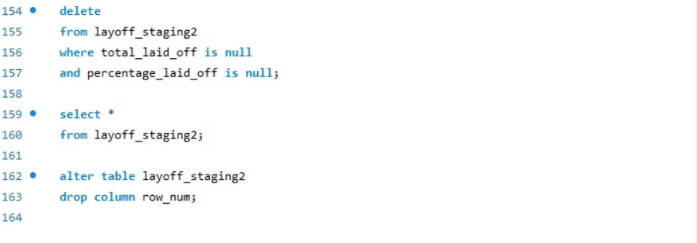
Step 4: Removing Useless Rows & Columns
The final step involves refining your dataset by removing any data that doesn't contribute to your analytical goals.
Identify & Delete

Slide 9
Thank You.
Feedback welcome.
- Palak Dave

